Slide 1




Wellness Guide
September 1, 2025 – August 31, 2026
Proviso Township High School District 209

Slide 2

Wellness Introduction
Proviso Township High School District 209 [PTHS] offers a Voluntary Wellness Incentive program for employees enrolled in one of the District sponsored group medical plans through Blue Cross Blue Shield of Illinois [BCBSIL].
The program outlines various activities that you may participate in to earn monetary rewards through a Lifestyle Savings Account [LSA].
PTHS has engaged Marquee Health and WEX, as third-party administrators to manage the program. Results of your biometric screenings and/or physician notes are protected by HIPAA [Health Insurance Portability and Accountability Act]. The District will not receive any personal health information.

Slide 3

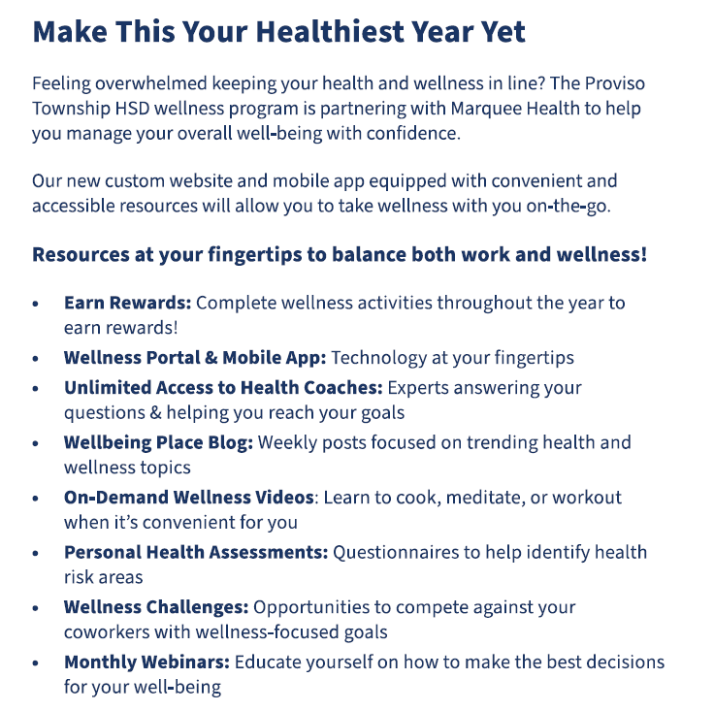
Marquee Health
For more information on our program, you may call Marquee Health at 800.882.2109 or email info@mywellportal.com

Slide 4






Proviso
2025 - 2026
Wellness Program
Unlock your potential. Reward yourself.
The 2025 - 2026 Proviso Wellness Program is offered to all medically enrolled employees. Beginning August 1, you can complete the qualifying wellness activities listed within the guide to begin earning Rewards Points to be eligible for a reward! This guide will help you understand each wellness activity and how to earn points upon completion.
Employees enrolled in the medical plan can earn up to $1,255 in your Lifestyle Spending Account [LSA].
Enroll Now and Start Earning Rewards!
Visit mymarqueehealth.com or scan the QR code to download the MyWellPortal app and log in with your personal username and password.
Use the following credentials to log in:
Username: Proviso Email Address
Password: DOB (MMDDYYYY)
Select the ‘Rewards’ tab at the top of the page to enroll in the 2025 - 2026 program.
800.882.2109
mymarqueehealth.com info@mywellportal.com

Slide 5
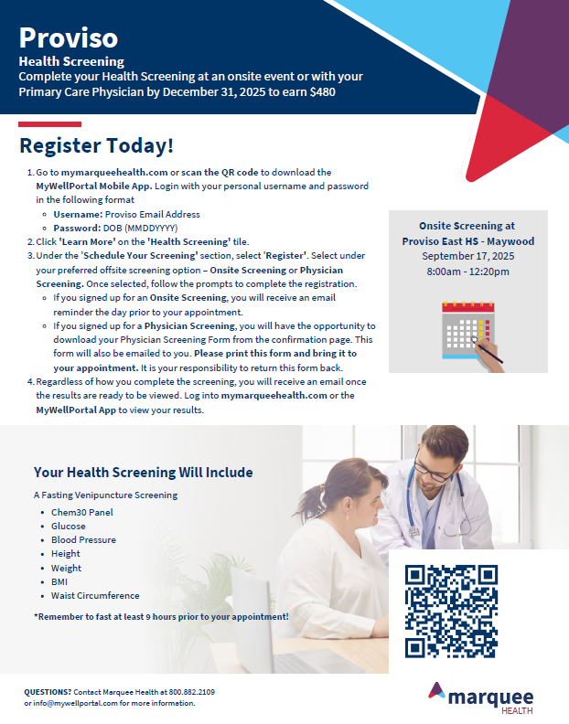

Slide 6


Slide 7
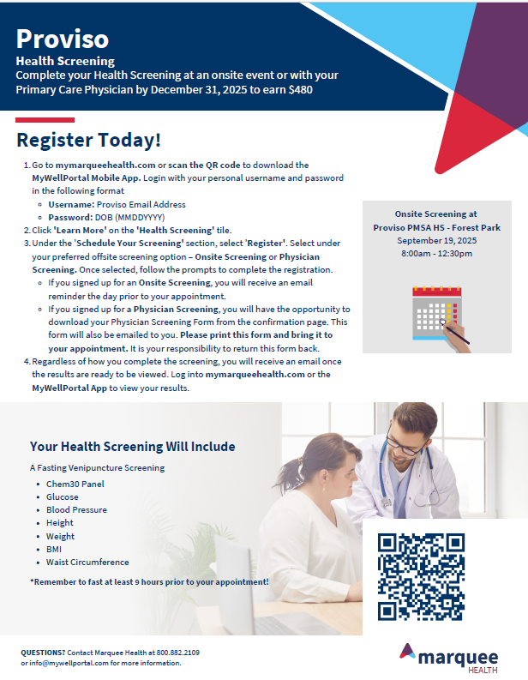

Slide 8

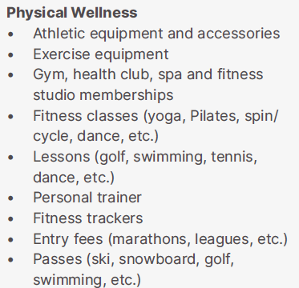
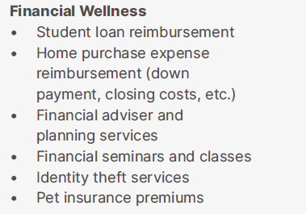
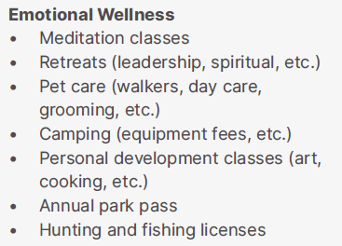
Lifestyle Savings Account (LSA)
As you complete activities with Marquee Health, your reward will be reflected in your LSA account with Wex.
What is an LSA?
An LSA isa benefits account set up & funded by post-tax employer contributions. You may spend your earned rewards on eligible expenses, as determined by the IRS. Eligible expenses are related to physical, financial and emotional wellbeing. The benefit meets the needs of everyone, no matter your stage of life, age or circumstance and is designed to improve your overall well being or lifestyle. You may spend our rewards on yourself or eligible dependents. Unused rewards cannot be cashed out.
What does an LSA cover?

Slide 9
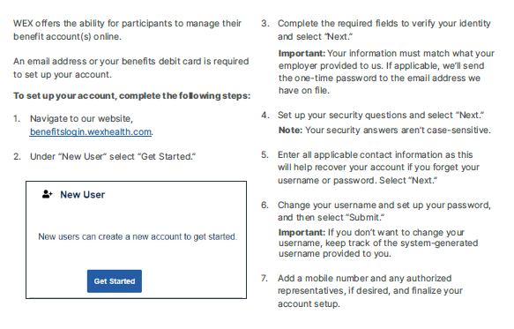
Lifestyle Savings Account (LSA)
Creating your personal account with WEX
  If you already have a WEX account (PTHS’s FSA), you can log in directly via the WEX Login screen.
  If you DO NOT have an account, you will receive a registration email once they process your enrollment. Your registration email will be sent to your PTHS email address.
  You may download the mobile app for free!

Slide 10
Lifestyle Savings Account (LSA)
Submitting your receipt for reimbursement?
Submit a reimbursement request with documentation showing the dates and types of service, also call substantiation. You may file a claim through your online account or through the WEX benefits mobile app.
You will automatically receive a check unless you enroll in direct deposit. Set up for your account is through your online account.
There is no minimum reimbursement requirement for direct deposit, however, a $25 minimum is required for checks to be issued. If your claim does not meet this minimum requirement, your reimbursement will be issued after you submit additional claims to bring your total to at least $25.
Processing time may be 2-8 business days for the check to arrive at your home; or 2-3 business days for funds to post to your bank account, once your claim is approved.

Slide 11
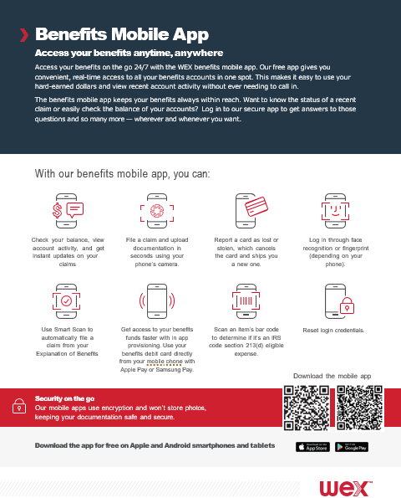

Slide 12
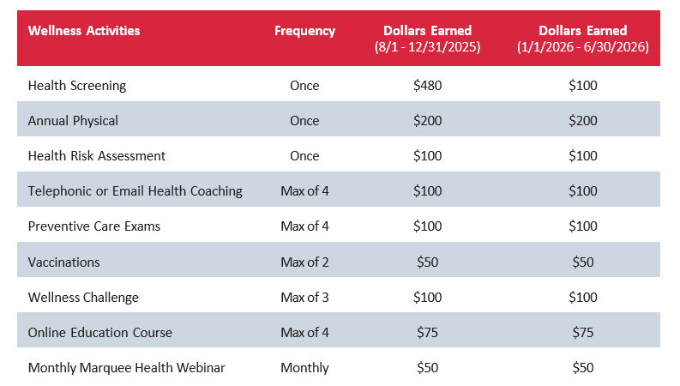

Marquee Health
Beginning August 1, 2025, you can complete any of the qualifying wellness activities listed in the below grid to earn rewards, up to $1,255. Earned rewards will be available through WEX’s Lifestyle Spending Account [LSA].

Slide 13




Qualifying Wellness Activities
Specifics on Your 2025 - 2026 Program
Health Screening
Complete your Health Screening conveniently at an onsite event or with your Primary Care Physician. Complete your annual screening by May 30th, 2026
How to Earn Rewards:
Your points will be awarded within 30 days of completing your screening. This activity can be completed
one time.
Annual Physical
Complete your Annual Physical through your Primary Care Physician. This activity can be completed one time.
How to Earn Rewards:
After completing your Annual Physical, log into mymarqueehealth.com and click on the ‘Rewards’ page. Select the log date, click on this activity, and enter the type of visit in the ‘Notes’ section. Click ‘Save’. This activity can be completed one time.
Health Risk Assessment
Learn more about your health and well-being by completing the Health Risk Assessment.
To get started, log into mymarqueehealth.com, and click on the ‘Health Assessment’ tile, then select the ‘Get Started’ button. After you answer all required questions, be sure to click the ‘Submit’ button to receive your results and personalized recommendations.
How to Earn Rewards:
Points will be awarded to your ‘Rewards’ page within 2 days of completing the health risk assessment. This activity can be completed one time.
Telephonic or Email Health Coaching
Health and wellness shouldn’t be complicated. Whether you are seeking to improve nutrition, manage stress, enhance fitness, or achieve holistic balance, we have a program tailored just for you. Our expert coaches are here to guide, support, and inspire you every step of the way.
To enroll in a free and confidential program, call a Marquee Health Coach at 800.882.2109 (Option 1), or email coaching@marqueehealth.com and mention Proviso. To earn points, you must enroll in coaching by May 25, 2026 and complete at least 4 weekly sessions by June 30, 2026.
How to Complete:
Your points will be awarded to within 15 days of completing your health coaching program. This activity can be completed 4 times per year.
For more information call us at 800.882.2109
or email info@mywellportal.com.

Slide 14
Qualifying Wellness Activities
Specifics on Your 2025 - 2026 Program
Preventive Care Exams
Earn points for completing your preventive care visits! Age or gender appropriate exams can include a dental exam, vision exam, mammogram, colonoscopy, prostate exam, skin cancer screening, annual physical or well woman visit.
How to Earn Rewards:
After completing your preventive care visit, log into mymarqueehealth.com and click on the ‘Rewards’ page. Select the log date, click on this activity, and enter the type of visit in the ‘Notes’ section. Click ‘Save’. You can log preventive visits once per month, with a maximum of 4 visits per year
Vaccinations
Have you gotten a preventive vaccine this year? Preventive vaccines can include a flu shot, tetanus shot, or COVID-19 vaccine.
How to Earn Rewards:
After receiving your vaccine, select the log date and enter the type of vaccine in the ‘Notes’ section, select ‘Yes’ and click ‘Save’. You can log vaccines once per month, with a maximum of 2 vaccines per year.
Wellness Challenge
Challenge yourself to practice healthy habits and have fun while competing with your co-workers. New challenges will be announced throughout the year and all challenge activity will be tracked on your ‘Challenges’ page. Stay tuned for
more details!
How to Earn Rewards:
Your points will be awarded with 15 days of completing a challenge. When offered, you can complete this activity up to 3 times per year.
Online Education Course
Are you ready to take charge of your personal well-being but don’t have time to connect with a dedicated health coach? Go at your own pace with Health Tracks and Online Education Courses. Topics include: nutrition, blood pressure,
physical activity, glucose, weight management, stress management, healthy lifestyle, tobacco cessation, and more!
How to Earn Rewards:
Your points will be awarded within 2 days of completing your online course. You can complete online education courses for points a maximum of 4 times per year.
For more information call us at 800.882.2109
or email info@mywellportal.com.

Slide 15
Qualifying Wellness Activities
Specifics on Your 2025 - 2026 Program
Montly Marquee Health Webinar
Stay up to date with well-being topics and research and join a monthly webinar. Register for the live webinar or view a past webinar on-demand. Visit the ‘Webinars’ page or use the drop-down menu under ‘Health Tools’
to access available webinars.
How to Earn Rewards:
After viewing the webinar, select the log date, enter the webinar topic in the ‘Notes’ section, select ‘Yes’
and click ‘Save’.
For more information call us at 800.882.2109
or email info@mywellportal.com.

Slide 16

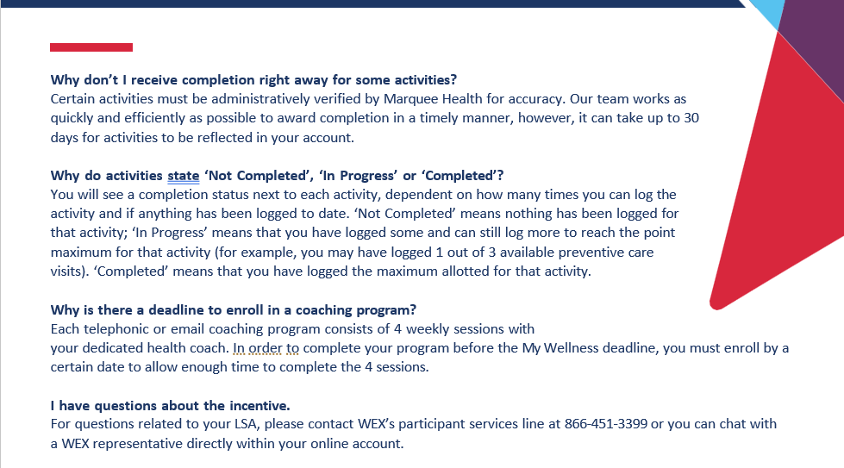
Program FAQs
For more information call us at 800.882.2109
or email info@mywellportal.com.

Slide 17

This document is designed to provide basic information regarding the Wellness program available to employees enrolled in one of our group sponsored BCBSIL health plans.. This document merely summarizes the employee benefit plans and programs and does not detail all of the terms, conditions, restrictions, and exclusions contained in the plan documents, carrier contracts and/or Summary Plan Descriptions (SPD) (the “plan documentation”) for the various benefit plans and programs. Every reasonable effort has been made to ensure the accuracy of the information contained in this document; however, in the event of a discrepancy between the information in this document and the plan documentation, the provisions described in the plan documentation will govern. This document does not create any contractual rights for any current or former employee, or for any other individual. The provisions of the applicable plan documentation will govern the determination of any individual’s rights under any employee benefit plan or program. Your employer reserves the right to amend or terminate any of its employee benefit plans and programs at any time and without notice or cause.
©2025 Brown & Brown. All rights reserved.

